Slide 1
Membership to Aim Higher

Slide 2
About the Residential Real Estate Council
RRC is the largest affiliate of the National Association of REALTORS® and recognized as the premier business development organization for REALTORS® and international real estate professionals
A community of more than 28,000 members
Represent the top residential REALTORS® in the industry
The Council awards the prestigious CRS (Certified Residential Specialist) Designation to experienced REALTORS® who:
Complete advanced professional training
Demonstrate outstanding professional achievement in residential real estate
The goal of the Council is to empower real estate professionals to reach their full potential through education, networking, referrals and business resources.

Slide 3
Reach new heights with RRC
The real estate industry is evolving every day and to be successful you have to stay at the forefront.
With RRC you will have the education, referrals, and resources you need to help you stay cutting-edge and reach your full potential.
RRC instructors are the best in the industry, and are active agents.
Join a supportive community of top producing agents ready to help you grow your career and send you referrals.
Stand out from competition and achieve the esteemed CRS Designation

Slide 4
Get best-in-class education
Live One-Day and Two-Day classroom courses consistently rank as best in the industry
RRC Certified Instructors – successful, proven practitioners offer expert business insights
Courses teach real-world solutions to challenges you are facing right now
eLearning courses and live/recorded webinars offer high quality, accessible content available 24/7
Members receive significant discounts on all RRC education and events
Members also receive up to 12 free topical and timely webinars annually

Slide 5
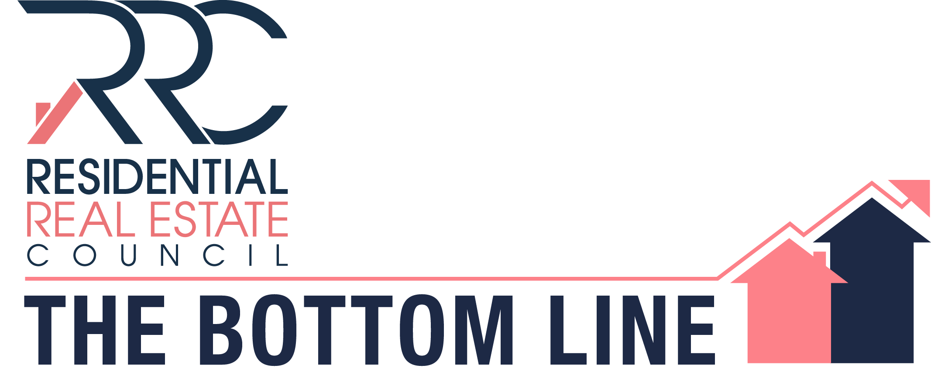
Stay informed
RRC helps keep members on the leading edge of the industry with timely industry information and business insights

Slide 6
Give and get qualified referrals
24/7 access to the growing international CRS-to-CRS Referral Network
Complimentary listing in the CRS Referral Directory (print, online, mobile app)
Complimentary access to the CRS Qualified Consumer Leads program
To-date, almost $20 million in commissions earned by CRS Designees
Use of CRS trademark and logo
Access to advertising and promotion opportunities exclusively for CRS Designees
Customizable CRS Designee marketing materials to help you differentiate your business

Slide 7
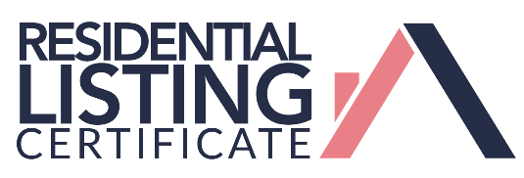
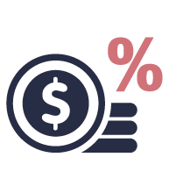
Get access to valuable resources
ANNUAL conference
FIND A CRS
REFERRAL Network
Professional
Development
Education
Discounts
Complimentary
Webinars

Slide 8
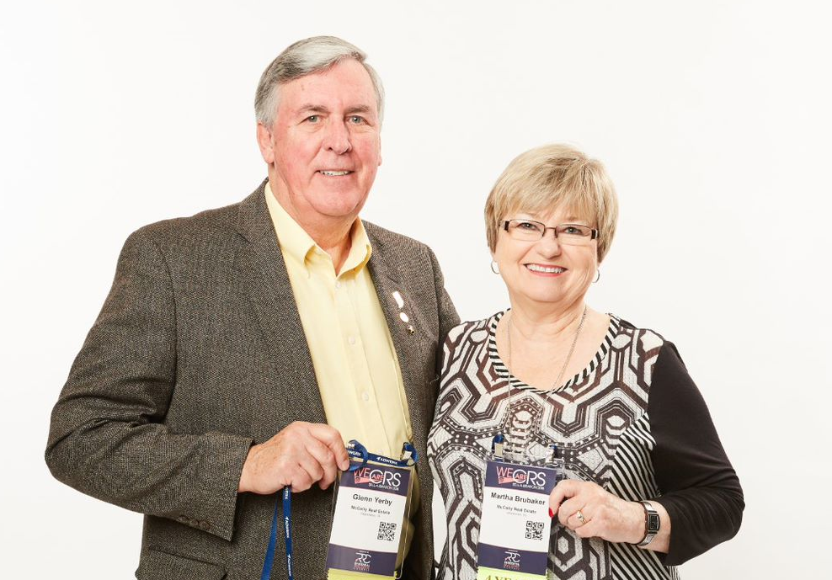
Get recognized
The CRS Designation is the most recognized and prestigious professional designation in the industry.
CRS Designees are among the most experienced, successful, highest-producing agents in the U.S. and overseas.

Slide 9
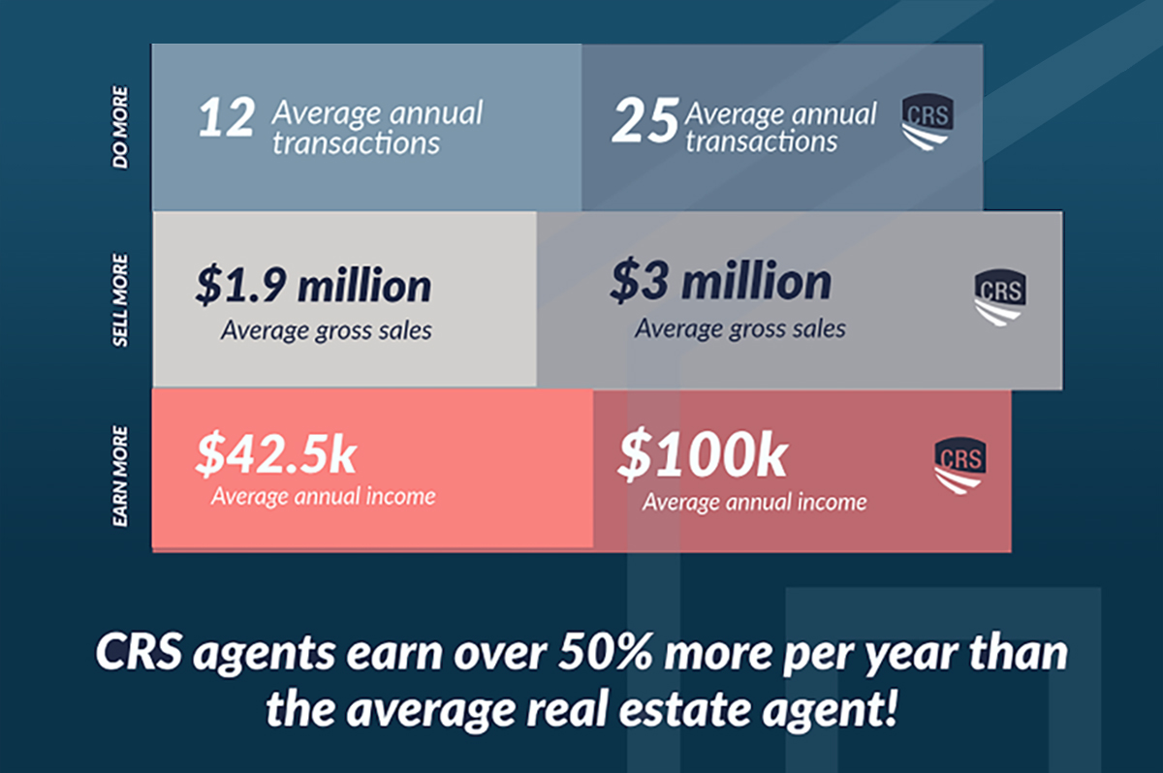
The Power of the CRS Designation
CRS Designees…
Have more experience
Earn more revenue
Generate more gross sales
Produce more transactions

Slide 10
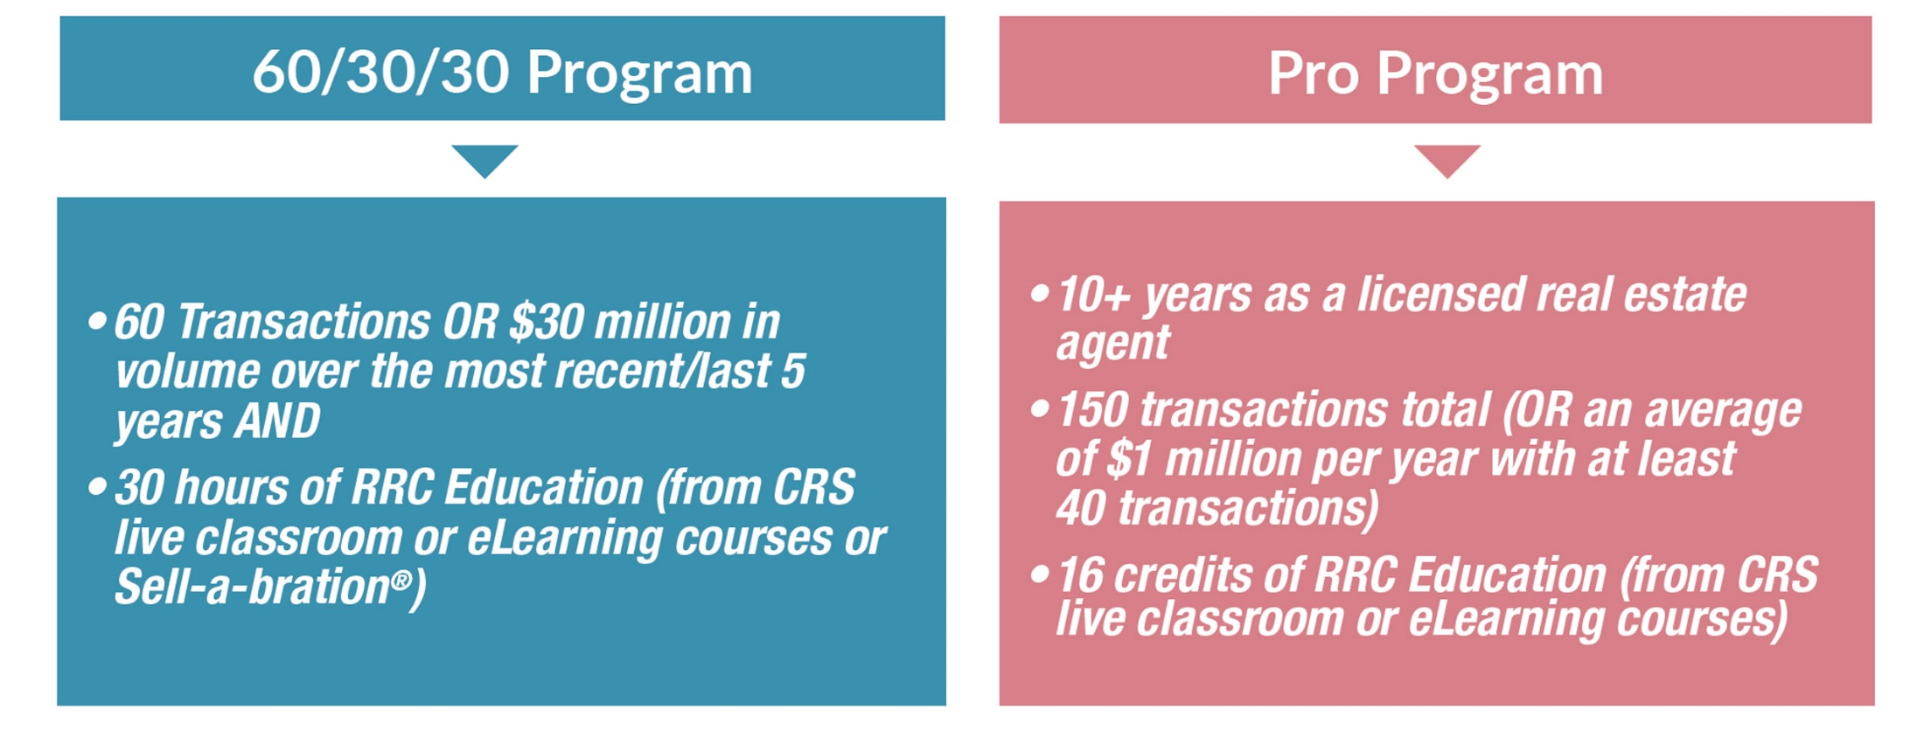
Choose your path to CRS Designation
RRC Education Credit is earned through CRS live classroom courses (one or two days) or eLearning courses

Slide 11
Join us
CRS Designees understand what it takes to succeed in the industry.
CRS Designees are the ones you want to refer to.
CRS Designees are a part of a supportive network.
YOU can be a CRS today.
www.crs.com/join

Slide 12
Not yet ready for the CRS Designation?
Take advantage of all RRC has to offer and start fulfilling your education requirements now.
Take advantage of the numerous RRC education offerings and attend RRC events.
When you do meet the experience and production requirements, you’ll be ahead of the game because your education history does not expire.

Slide 13
Questions?
Call us: 1-800-462-8841
Or email: crshelp@crs.com

Slide 14
Engage with us on social media
Twitter.com/ThisIsRRC
Facebook.com/ThisIsRRC
Instagram.com/ThisIsRRC
Linkedin.com/company/residential-real-estate-council/
Youtube.com/residentialrealestatecouncil
Pinterest.com/thisisrrc

